Slide 1
intro to html
MCNDHS
Ms. Eng

Slide 2
aim: How are webpages constructed by html?
Do Now:
Please compare and contrast the following sentences:
I love to be creative.
I hate to be creative.
daily Grade:
On time: 25%
No cellphone: 25%
Notes: 25%
Classwork/Homework: 25%

Slide 3
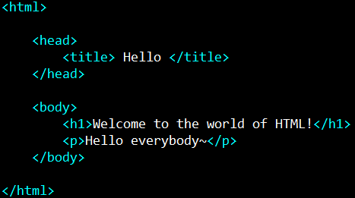
html vocabulary
When you write in HTML, the “alphabet” are called ELEMENTS/TAGS
example:

Slide 4
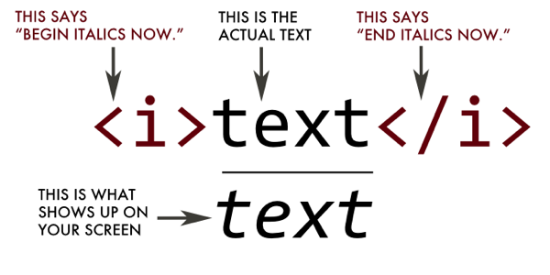
what do elements/tags do?
Think of tags as a RULE. You place the text in between the tags to “code”

Slide 5
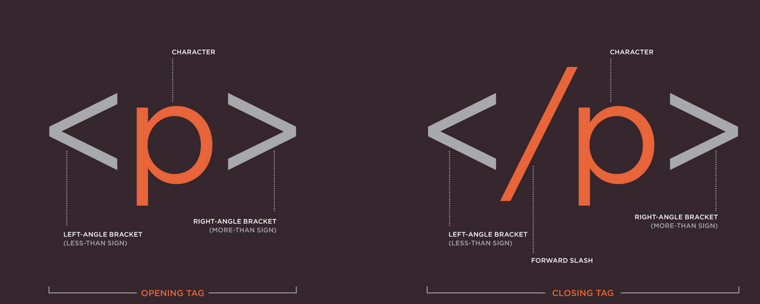
the anatomy of tags
Opening tag
Closing tag

Slide 6


how do browsers translate your code?
Code→rendering engine→display
html
css
javascript
is read by C++ commands
C++ orders computer hardware to display your creation!
html
css
javascript

Slide 7
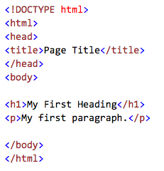
every webpage is structured like this:
webpage
what appears on the top of the browser
everything inside <html> means what you are coding is in html.
the physical content that will appear on your website.

Slide 8
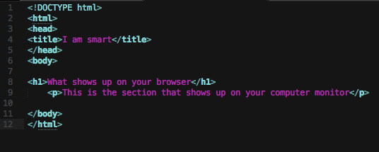
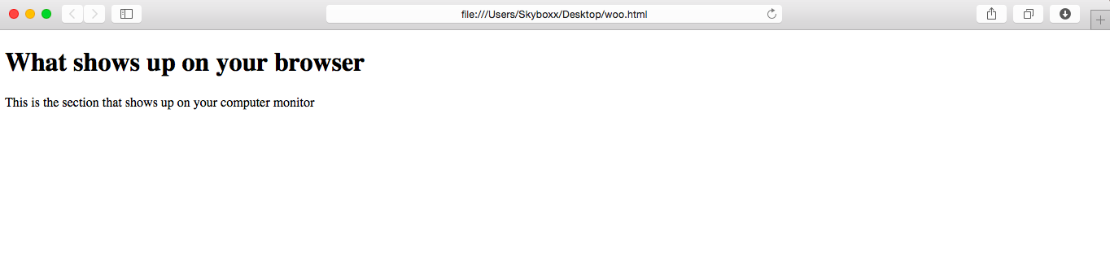

Slide 9
activity
Please locate and list all the opening and closing tags you see!

